Slide 1
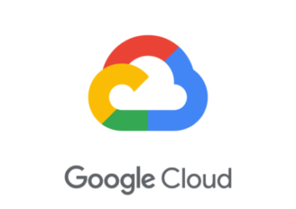
Mitigating Security vulnerabilities on Google Cloud Platform
By- Prithish Ghosh
Welcome to Mitigating Security Vulnerabilities on Google Cloud Platform!
In this session we will expect to learn more about security tools available to you when using Google Cloud, and how to use them to lower the risk of malicious attacks against your systems, software and data & vulnerability scanning.

Slide 2
What is Cloud security ??
Cloud security, also known as cloud computing security, consists of a set of policies, controls, procedures and technologies that work together to protect cloud-based systems, data, and infrastructure.
These security measures are configured to protect cloud data, support regulatory compliance and protect customers' privacy as well as setting authentication rules for individual users and devices.
cloud security can be configured to the exact needs of the business. And because these rules can be configured and managed in one place, administration overheads are reduced and IT teams empowered to focus on other areas of the business.

Slide 3
Security sources for vulnerabilities threats ::
A list of the Google Cloud security sources that are available in Security Command Center. When you enable a security source, it provides vulnerability and threat data in the Security Command Center dashboard.
Security Command Center enables you to filter and view vulnerability and threat findings in many different ways, like filtering on a specific finding type, resource type, or for a specific asset. Each security source might provide more filters to help you organize your organization's findings.
Vulnerabilities : Vulnerability detectors can help you find potential weaknesses.
Security Health Analytics vulnerability types : Security Health Analytics managed vulnerability assessment scanning for Google Cloud can automatically detect common vulnerabilities and misconfigurations across:
Cloud Monitoring and Cloud Logging
Compute Engine
Google Kubernetes Engine containers and networks
Cloud Storage
Cloud SQL
Cloud Identity and Access Management (Cloud IAM)
Cloud Key Management Service (Cloud KMS)
Cloud DNS

Slide 4
Web Security scanning for vulnerability mitigation in Cloud
Web Security Scanner provides managed and custom web vulnerability scanning for public App Engine, GKE, and Compute Engine serviced web applications.
Types of scanning : 1. Managed scans 2. Custom scans
Managed scans
Web Security Scanner managed scans are configured and managed by Security Command Center.
Managed scans run separately from custom scans that you define at the project level. You can use managed scans to centrally manage basic web application vulnerability detection for projects in your organization.
When you enable Web Security Scanner as a service, managed scan findings are automatically available in the Security Command Center vulnerabilities tab and related reports. For information about how to enable Web Security Scanner managed scans, see configuring Security Command Center.
Custom scans
Web Security Scanner custom scans provide granular information about application vulnerability findings, like outdated libraries, cross-site scripting, or use of mixed content. Custom scan findings are available in Security Command Center after you complete the guide to set up web security scanner custom scans.

Slide 5
Best Practices to run a scan for vulnerabilities :
Security Health Analytics :
2-Step verification findings : The 2SV_SCANNER detector identifies vulnerabilities related to 2-step verification for users.
API key vulnerability findings :
Run scans in a test environment.
Use a test account
Block individual UI elements
Use backup data
Excluded URLs
3. Compute image vulnerability findings :

Slide 6
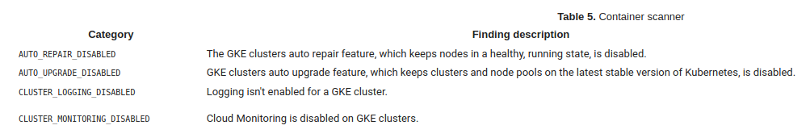
Container vulnerability findings :
These finding types all relate to GKE container configurations, and belong to the CONTAINER_SCANNER detector type
Other vulnerabilities:
Dataset vulnerability findings
DNS vulnerability findings
Firewall vulnerability findings
IAM vulnerability findings
Logging vulnerability findings
Monitoring vulnerability findings
Network vulnerability findings
SQL vulnerability findings

Slide 7
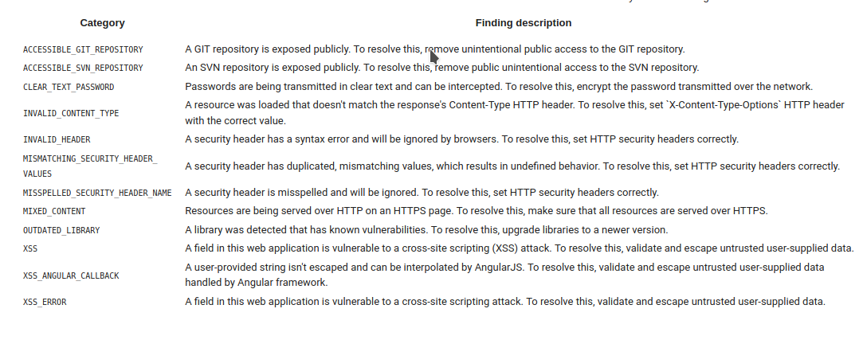
Web Security Scanner findings :
A one-line description of it

Slide 8
.
Cloud Data Loss Prevention
Cloud DLP Data Discovery enables you to surface the results of Cloud Data Loss Prevention (Cloud DLP) scans directly in the Security Command Center dashboard and Findings inventory. Cloud DLP can help you to better understand and manage sensitive data and Personally Identifiable Information (PII) like the following:
Credit card numbers
Names
Social security numbers
US and selected international identifying numbers
Phone numbers
Google Cloud credentials
Monitoring & Logging ::
Brute force SSH Attack :: Event Threat Detection detects brute force of SSH by examining SSH logs for repeated failures followed by success.
Cryptomining: Event Threat Detection detects coin mining malware .
Phishing: Event Threat Detection detects Phishing by examining VPC logs for connections and other log data.

Slide 9
Hands-on session :
BY- Prithish Ghosh
Qwiklabs quest for vulnerability scanning ::
“Cloud Security Scanner: Qwik Start”
Link :https://www.qwiklabs.com/focuses/1715?parent=catalog
My blog :
https://medium.com/@prithishghosh/how-to-start-cloud-security-scanner-google-cloud-platform-e51c81ab12cb?source=friends_link&sk=1fabe701a86e6033727ce2f25d47b9a5

Slide 10

Thanks!
Contact me :
Linkedin : https://www.linkedin.com/in/prithish-ghosh-097207163/
Twitter : https://twitter.com/PrithishGhosh5

